Slide 1


EDA
Exploratory Data Analysis
Handling Missing Values and Duplicate Data
Edelweiss Saraswati Priyono

Slide 2

Steps
01 - Read Dataset
02 - Data Summary
03 - Checking Missing Values
04 - Handling Duplicate Data

Slide 3
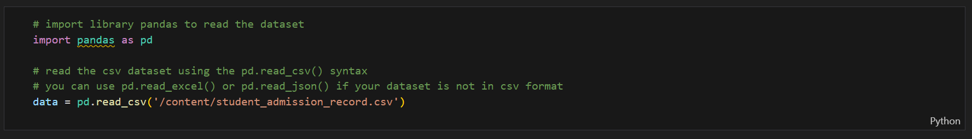

01 - Read the Dataset

Slide 4
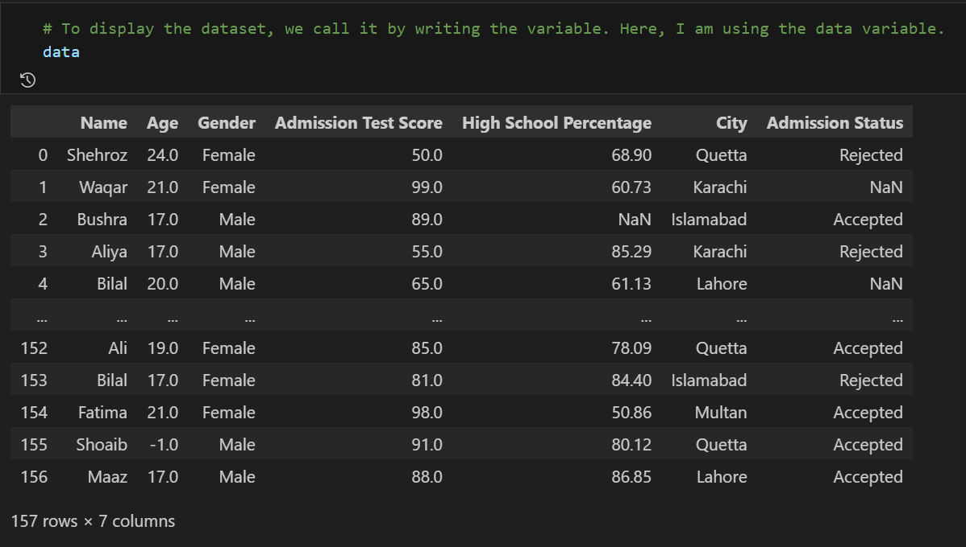
01 - Read the Dataset

Slide 5
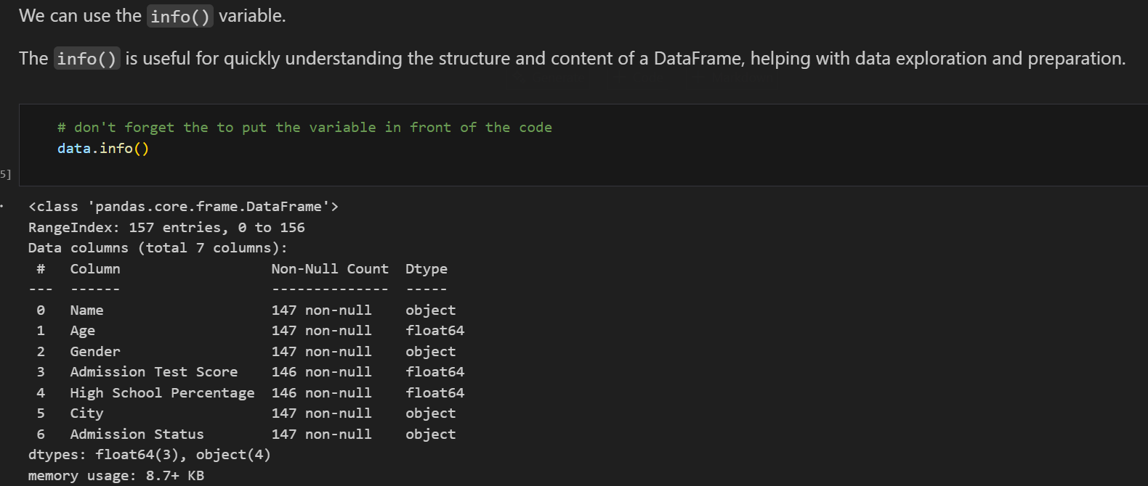
02 - Data Summary

Slide 6
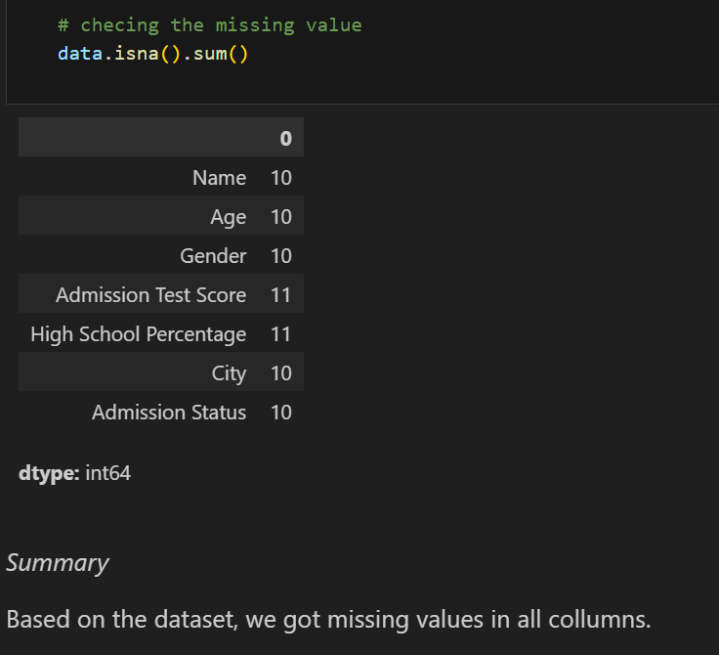
03 - Checking Missing Value

Slide 7
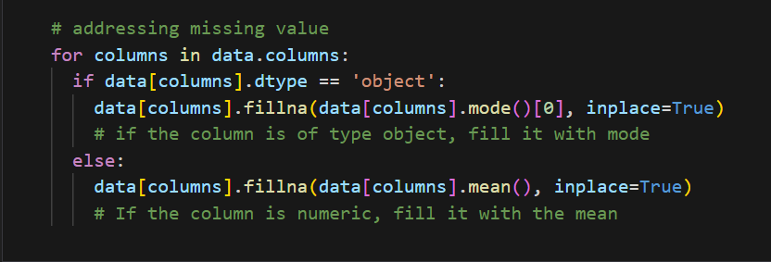
Addressing Missing Values

Slide 8
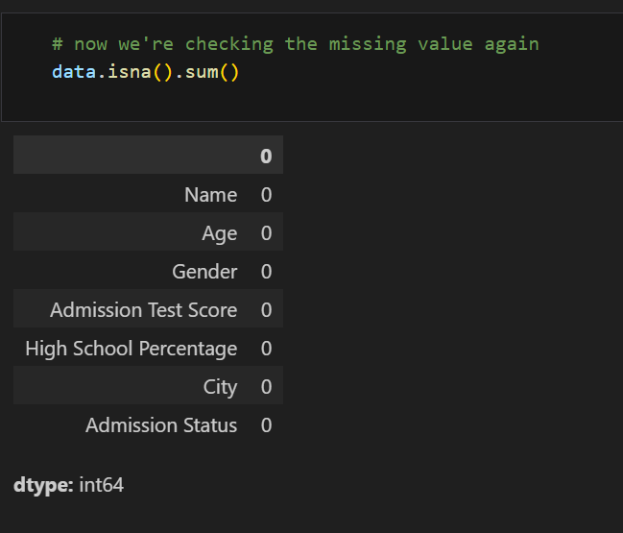
Checking on the Missing Values again

Slide 9
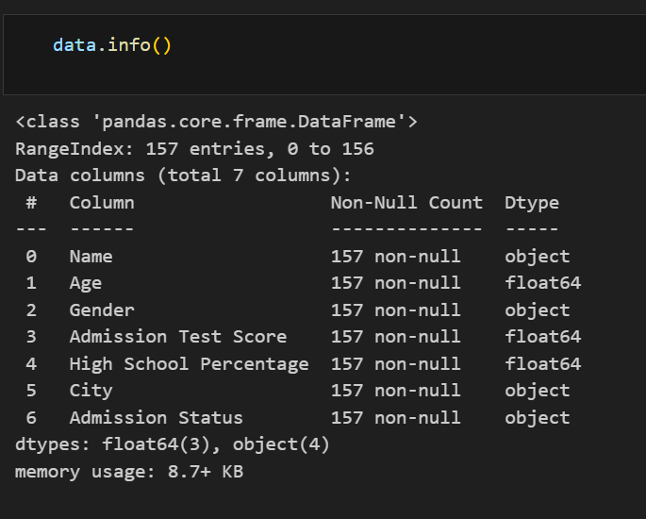
Checking on the Missing Values again

Slide 11
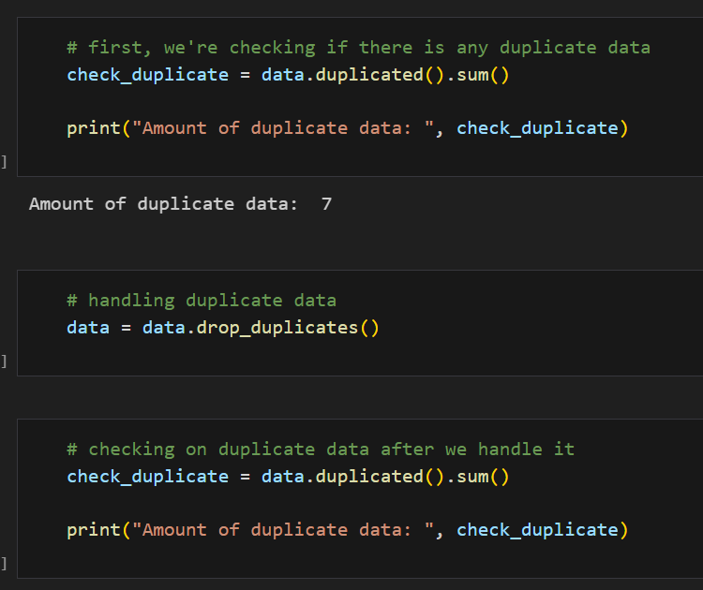
04 - Handling Duplicate Data

Slide 12



Thanks!
LinkedIn
GitHub
Edelweiss Saraswati Priyono

